Slide 2
Campus Facts
1,300 students
50% commuter/50% residential
4 campus locations
Lancaster, PA

Slide 3
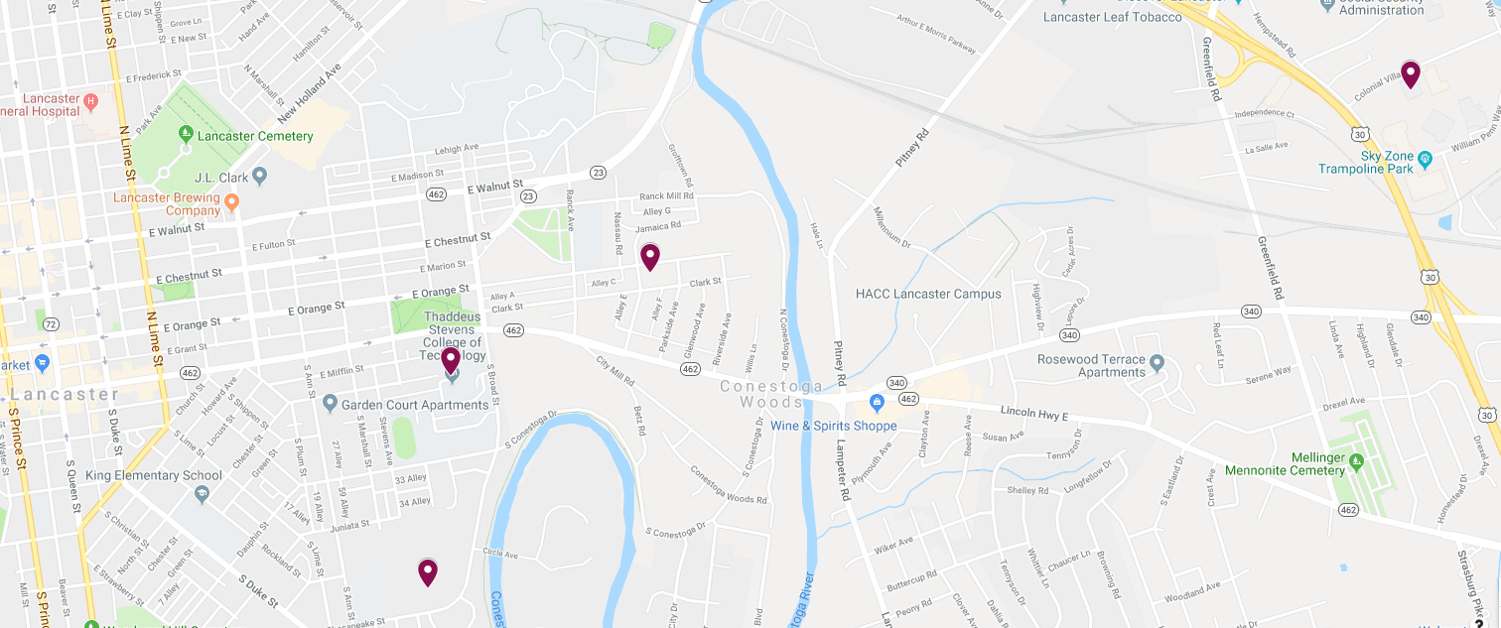
Colonial Village
location
Thaddeus Stevens On Orange
Main Campus
Greiner Center for Advanced Manufacturing

Slide 4
The options

Slide 5
Types of programs
Associate’s degrees
2 years
Certificates
1 year
Short term
Weeks

Slide 6
Short term
Production welding
6 weeks
Facilities maintenance
24 weeks
Who to contact?
Amy Welsh
717-391-6950
welsh@stevenscollege.edu

Slide 7
Certificates
Electrical Construction and Maintenance
1 year or 9 months

Slide 8
Associate degrees
Two year time frame
Associate’s of Applied Science
Full time
Monday – Friday
Day time
Classes occur between 7:30 a.m. and 4:30 p.m.
Occasional evening section
Hands on
Small class size
25 students per program

Slide 9
What to study

Slide 10
MAKE
Automotive Technology
Collision Repair Technology
Computer Integrated Machining
Metal Casting Technology and Manufacturing Management
Metals Fabrication/Welding Technology
Welding Technology

Slide 11
BUILD
Cabinetmaking and Wood Technology
Carpentry Technology
Heating, Ventilation, Air Conditioning & Refrigeration
Masonry Construction Tech.
Plumbing Technology
Residential Remodeling

Slide 12
CREATE
Architectural Technology
Business Administration
Computer & Network Systems Administration
Computer Software Engineering
Electrical Technology
Electronic Engineering Technology
Electro Mechanical Technology
Engineering CAD Technology
Graphic Communications and Printing Technology
Mechanical Engineering Technology
Water Environmental Technology

Slide 13
The Next Step after Thaddeus Stevens College of Technology

Slide 14
Career
2 year time frame
Prepared in class
Industry connection
Other Institutions
Middle States accreditation
Articulations
Transferring

Slide 15
Careers after TSCT
96% job placement
6.6 jobs/graduate
Yearly career fair
Internships
99% paid

Slide 16
Careers after TSCT
Construction Division
327 graduates
2,014 companies recruiting
3,297 jobs posted
10.1 jobs/grads

Slide 17
Careers after TSCT
Manufacturing Division
407 graduates
3,774 companies recruiting
6,173 jobs posted
15.2 jobs/grad

Slide 18
Heavily Recruited Programs
Electrical
Electro-Mechanical
Engineering CAD
HVAC-R
Computer Integrated Machining
Metals Fabrication and Welding
Welding

Slide 19
MyFuture Career
https://www.myfuturecareer.us/

Slide 21
Campus Life

Slide 22
Athletics and Clubs
5 intercollegiate sports
Football, basketball, cross country, track and field and wrestling
Over 20 clubs and organizations
Boxing club, outdoor club, student congress, Phi Theta Kappa

Slide 23
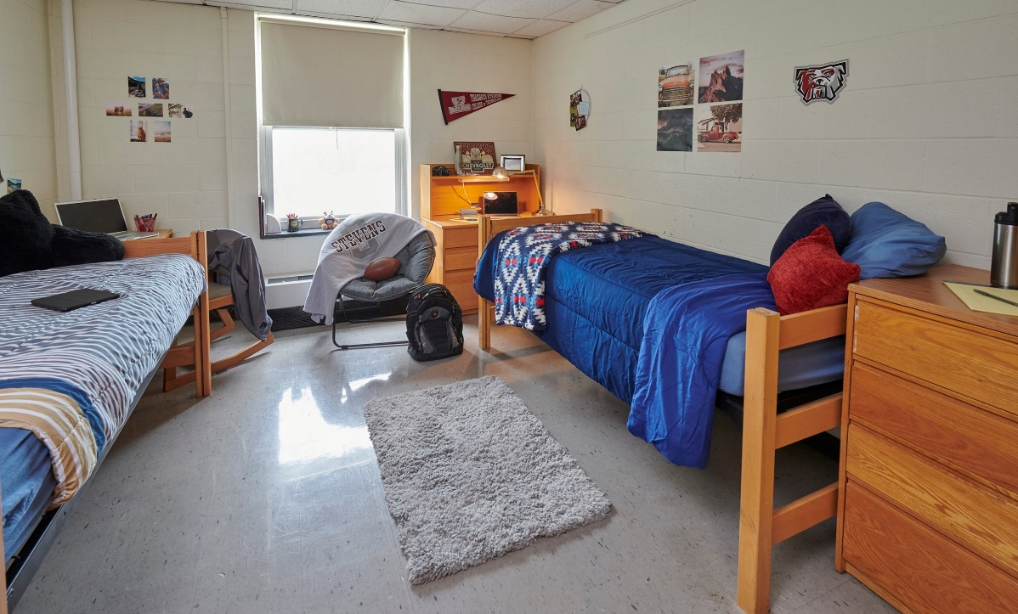
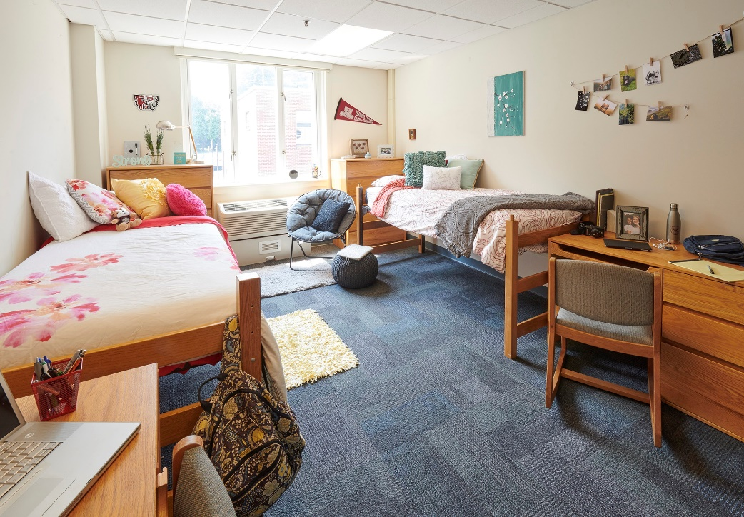
On Campus Housing
50% resident students
Housing available –
Main Campus
On Orange

Slide 24
The Cost and Financial Aid

Slide 25
The Cost
 | Commuter | Resident
Tuition | $8,400 | $8,400
Room | $0 | $5,000
Meal Plan | *Optional | $3,700-$4,670
Total | $8,400 | *$18,070

Slide 26
How to pay for college
FAFSA = Free Application for Federal Student Aid
October 1 – May 15
Scholarships
Internal and external
Grants
Stevens Grant
Loans

Slide 27
The Stevens Grant
Must file the FAFSA
If Pell Grant eligible = Stevens Grant eligible
Grant can cover completely OR reduce the cost of –
Textbooks
Tools

Slide 28
Applying to Thaddeus Stevens College of Technology

Slide 29
The steps to apply
Online application
Application fee or fee waiver
Official high school transcript/GED scores
SAT/ACT scores (optional)

Slide 30
Timeline – Seniors & High School Graduates
Apply as soon as possible
Submit transcript
Submit application fee or waiver

Slide 31
How to submit items?
Email
Admissions@stevenscollege.edu
File upload
Naviance/Parchment

Slide 32
Timeline - Underclassmen
Applications now open
Submit transcript
Submit application fee or waiver

Slide 33
Questions?

Slide 34
Admissions questions
Admissions@stevenscollege.edu
Financial aid questions
Financialaid@stevenscollege.edu
Program of study questions
Admissions@stevenscollege.edu

Slide 35
Thank you!

