Slide 1
Welcome New Students!
Accepted Student Days 2026

Slide 2

Welcome Caregivers and Parents
Accepted Student Days 2026

Slide 3
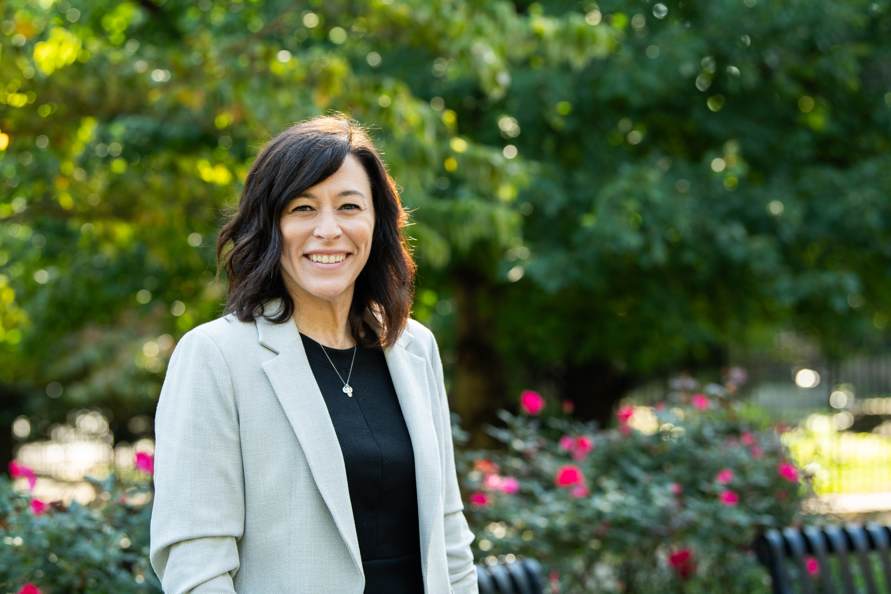
Welcome Parents and Caregivers!
Dr. Melissa Wisniewski
Dean of Enrollment Services

Slide 4
Agenda
Student Success
Career Services
Residence Life
Student Services
Student Accounts
PSECU Partners
General Q&A

Slide 5
Student Success and
the Academic Center
Dr. Michael DeGroft | Dean of Student Success

Slide 6
Overview of Academic and Related Supports
Academic Coach
Academic Advisor
Counselor
Accessibility Services
Library Services
Tutors – math and English
Peer Tutors
Tutor.com
Attendance Policy

Slide 7
Parent/Caregiver Role
  Encourage your student to speak with their Academic Coach early on
  Check stevens email daily and respond to emails!!!!!!!!!!!!!
  Coach your student on what they should be asking
  Encourage your student to meet with their instructor about academic questions.
  ALL students struggle. Remind your student this is normal. It will be more difficult than high school.
  When frustrated, concerned or the student feels lost, encourage them to speak up and advocate for themselves.

Slide 8
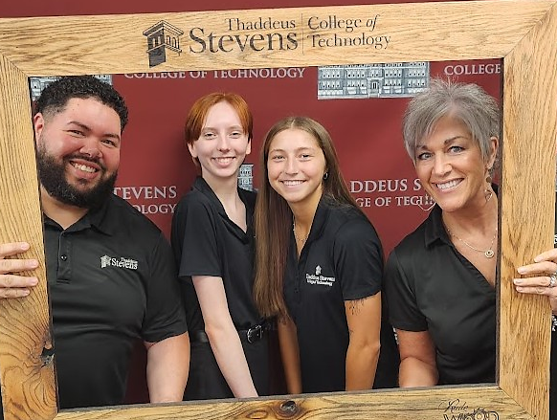
Career Services
Laurie Grove | Director of Career Services

Slide 9
WHY STUDENTS CHOOSE TSCT?
LOCATION
AFFORDABILITY
TWO YEARS (vs. FOUR)
INDUSTRY ALIGNMENT
  GOOD JOBS! (with advancing career paths)
  FAMILY-THRIVING WAGES

Slide 10

Top Five Skills Employers Seek
RESILIENCE: To persist through adversity and never give up on yourself or your team
INTEGRITY: To Be honest and take ownership of your actions regardless of the consequences
PROBLEM SOLVING: To think through complex issues, identify and create solutions to those issues
COMMUNICATION: To effectively communicate with all different types of people in oral, verbal, written, and non-verbal forms
TEAMWORK: To collaborate with others and compromise when necessary for the betterment of the team

Slide 11
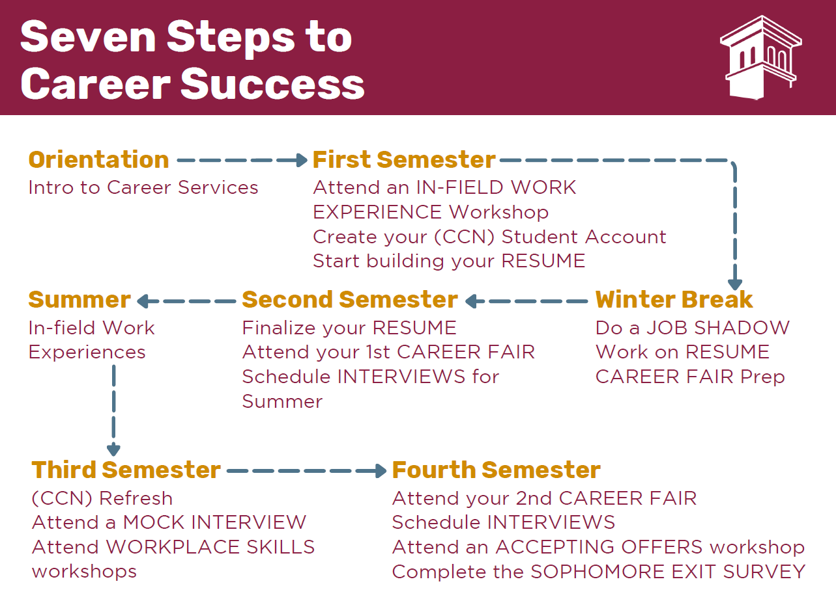

Slide 12
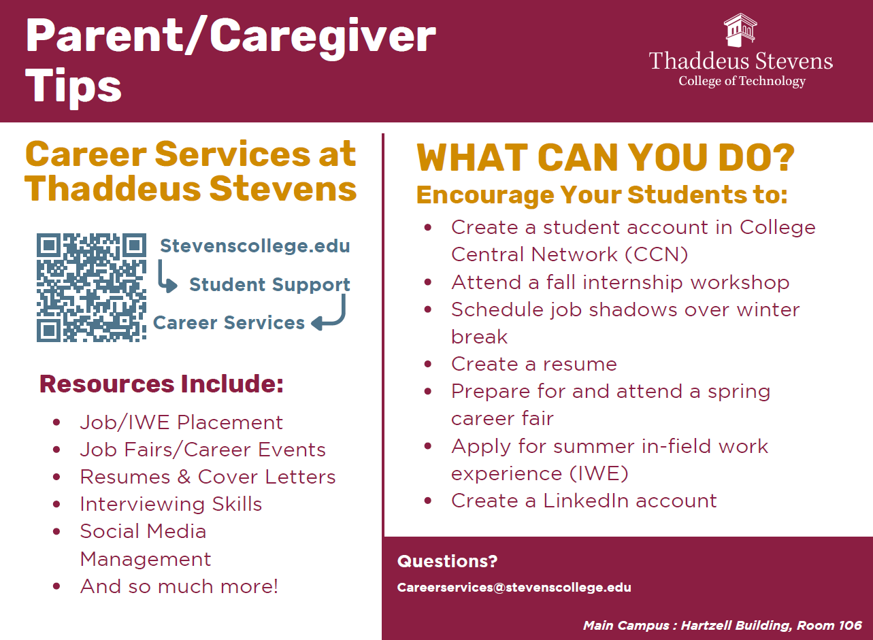
www.CollegeCentral.com/STEVENS

Slide 13
Career Services FAQs
Summer Internships: In-field Work Experience (IWE)
Are Internships guaranteed or required for graduation? No. While roughly 50-60% of our students do participate in an infield work experience while at TSCT, many companies do not have the capacity to bring on a student for the summer
Are Internships paid? Yes
College Transfer: Postsecondary Articulation Agreements
Can students transfer TSCT credits to a 4-year college? Yes, see link above for more information. Students should reach out to Career Services for assistance: CareerServices@StevensCollege.edu
Job Search Help:
My son graduated last year and is looking to relocate? Can he still access Career Services resources? Yes, the Career Center is available to ALL currently enrolled students and Alumni of Thaddeus Stevens College: CareerServices@StevensCollege.edu | CollegeCentral.com/STEVENS.
Career Fairs: Career Fairs - Thaddeus Stevens College of Technology
When are they and how can my student prepare for them? See link above for information on our Spring 2026 Career Fair events. ALL students will attend a Career Fair workshop prior to the events and have 24/7 access to Career Fair prep resources via their student portal, THAD’s PAD ➔ Career Services (requires TSCT login)

Slide 14
PARENT TIPS TO START NOW
Encourage your student to “FAIL-FORWARD”
  “Mistakes are simply opportunities to begin again more intelligently” ~Henry Ford
Help your student to obtain a DRIVER’S LICENSE
JOB SEARCH starts now!
  Help your student create a STUDENT account in CCN, our internal job search system (www.CollegeCentral.com/STEVENS):
    Check out the companies/jobs currently in the system
    New opportunities are added daily - including part-time ON CAMPUS JOBS!
Ask your student about THAD’S PAD ➔ Career Services (24/7 online resource)
Remind your student to connect with Career Services First Semester
Questions? Reach out! CareerServices@Stevenscollege.edu

Slide 15
Residence Life
Dawan Worsley | Director of Residence Life
Khadijah Lyons | Assistant Director of Residence Life

Slide 16
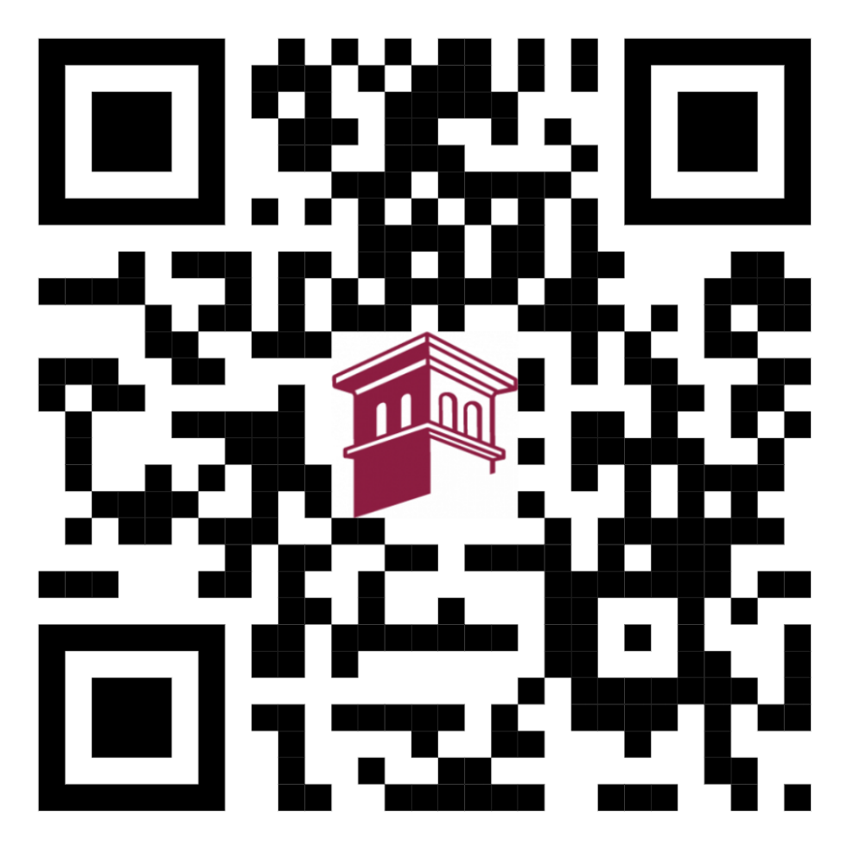
Living on Campus
On the Residence Life Page, You’ll Find:
The Housing Selection Process and Tutorial Video
Residence Hall Information
Move-In & Move-Out Resources
Move-In Packing Guide
Residence Life Contact Information
And More
What Can You Do?
Encourage Your Student To:
  Complete the Housing Application As Soon as Possible!
  Review Our Residence Hall Options
  Familiarize Themselves with Residence Hall Policies
  Check Their Emails Daily for Housing Updates and Deadlines
  Connect with Residence Life Staff with Questions
SCAN TO ACCESS OFFICE OF RESIDENCE LIFE PAGE
Apply for Housing TODAY!

Slide 17
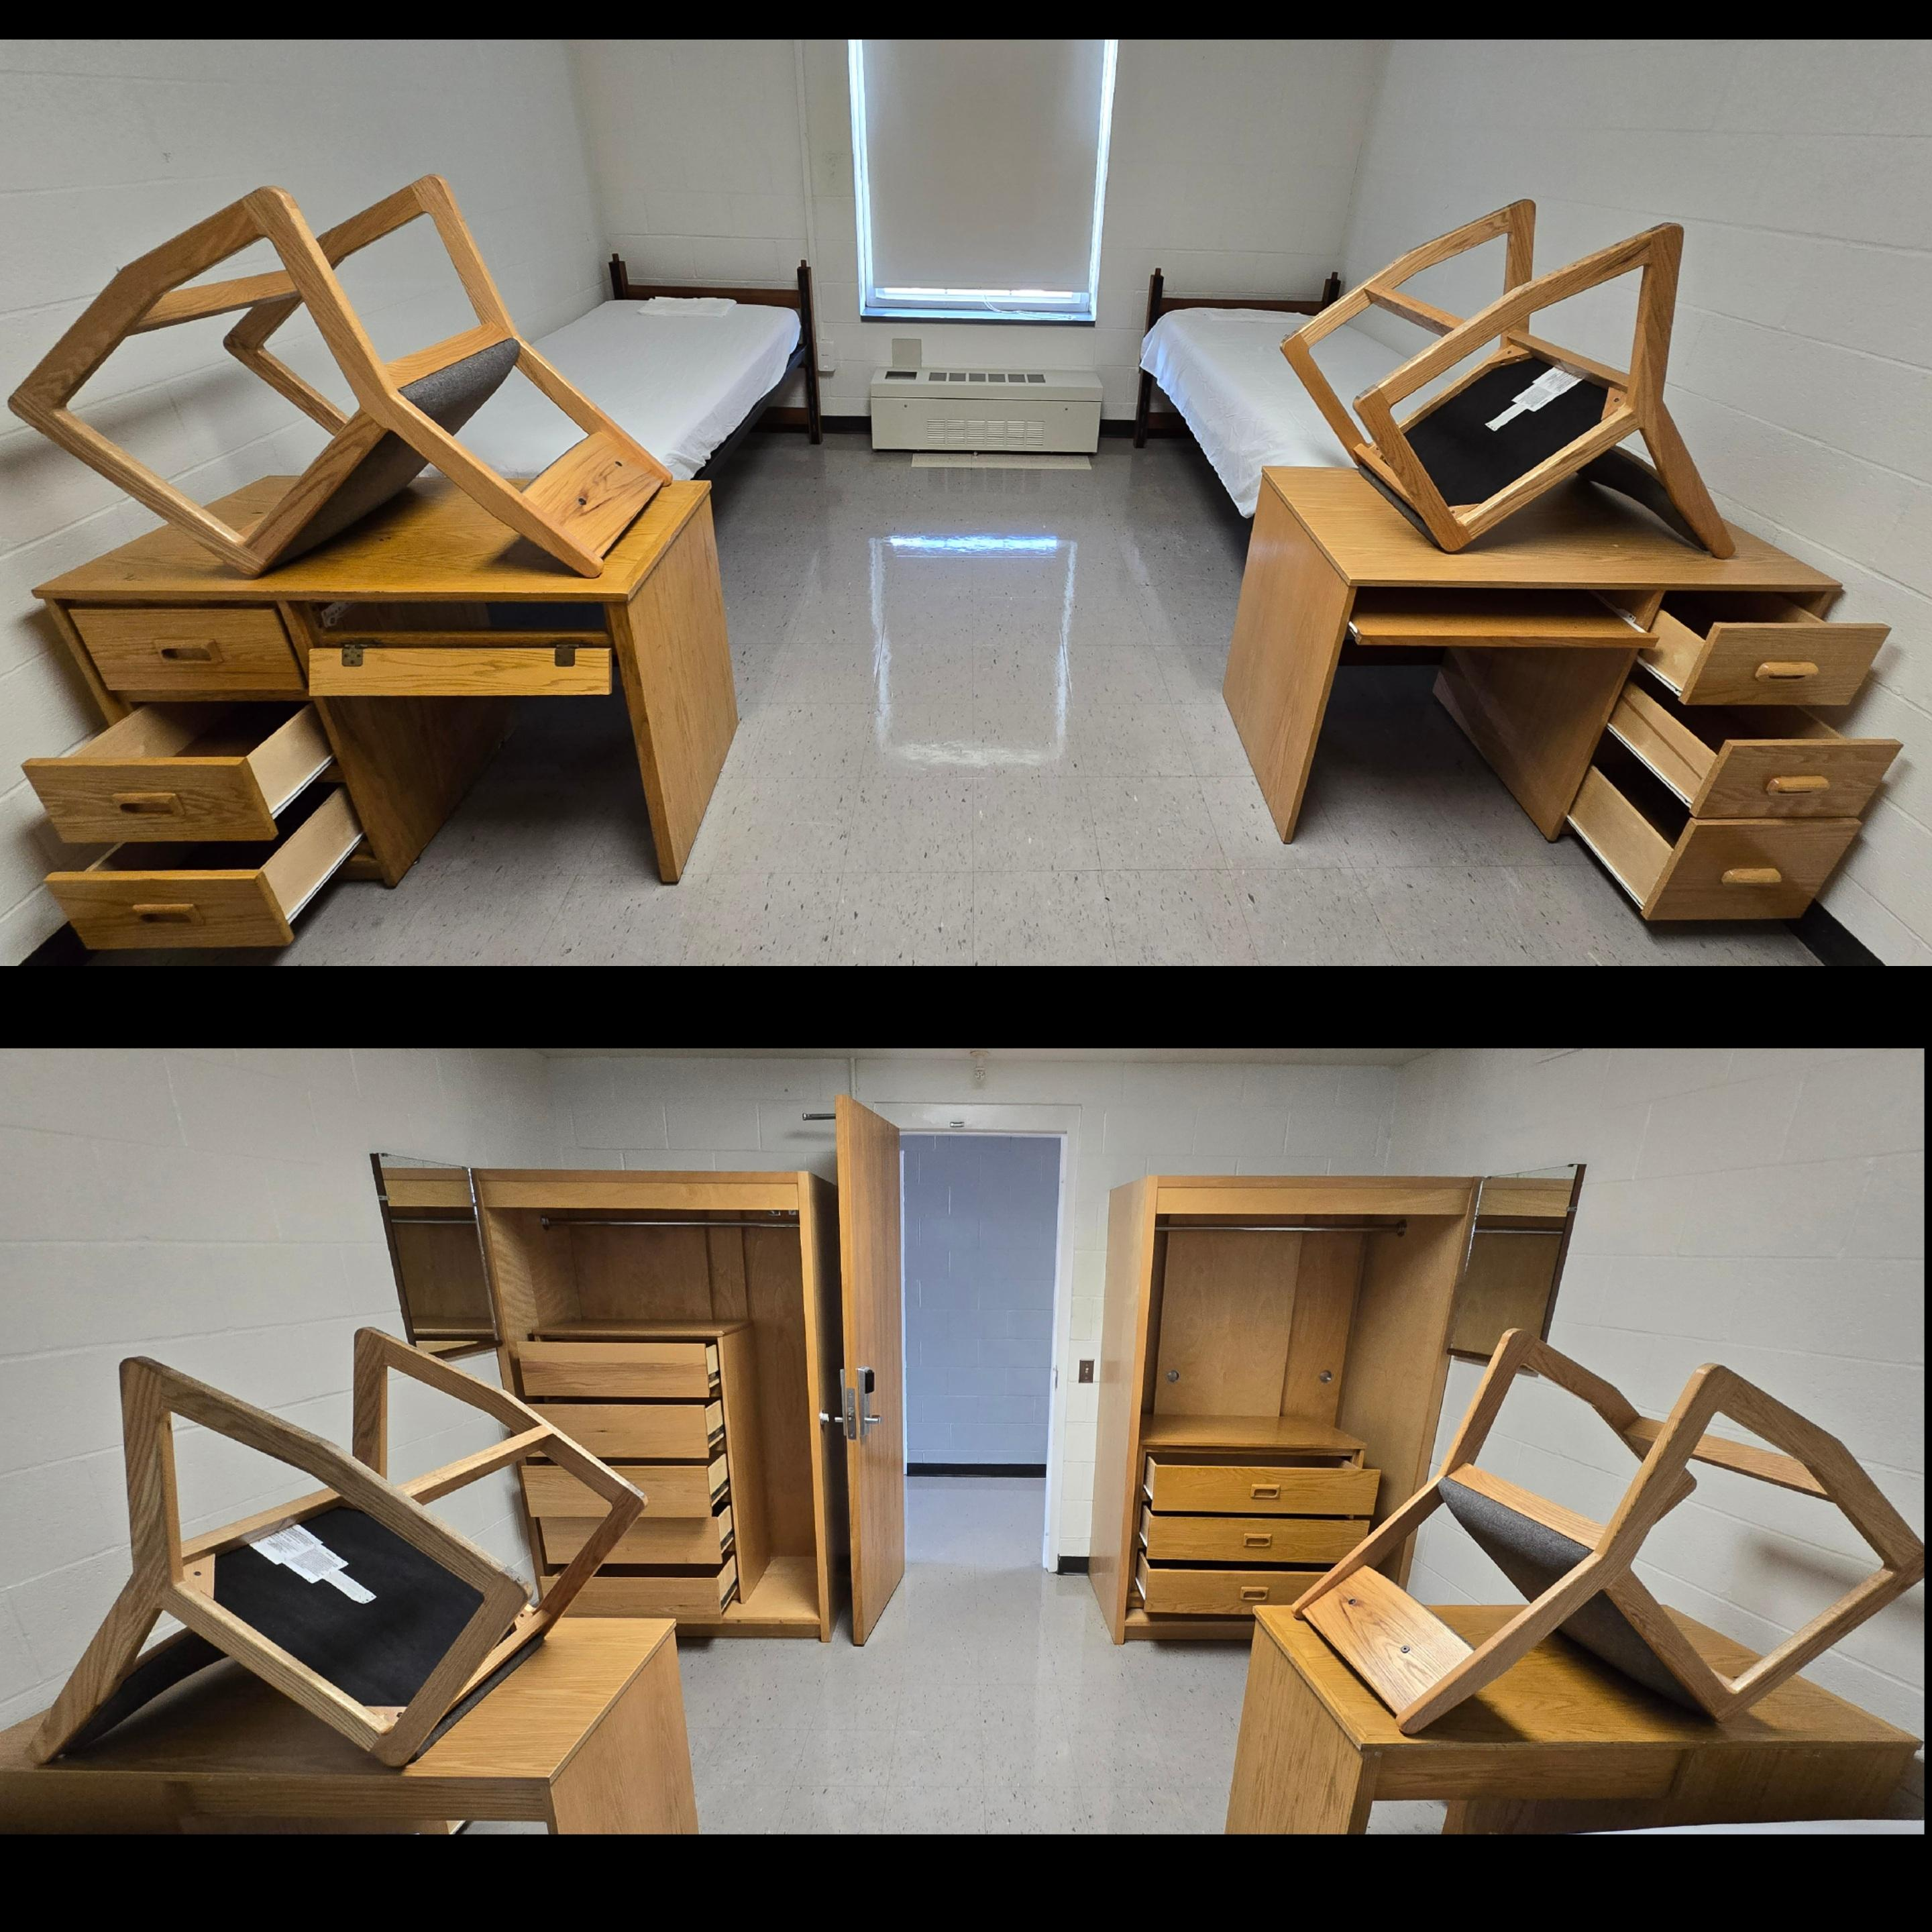
Living on Campus

Slide 18
Student Services
Dr. Christopher Metzler | VP of Student Services

Slide 19
Student Services and Athletics Overview
Athletics
Basketball
Cross Country
Football
Track & Field
Wrestling
Dining
3 Dining Locations
Dietary Accommodations
Variety of Meal Options
Security
24/7 Coverage
(717) 391-7225
Parking & Safety Support

Slide 20
Student Services and Athletics Overview
Health Services
Campus Nurses
Insurance Assistance
Shuttle Services
Transportation Between Campuses
Based on the Academic Schedule
Residence Life
Housing Support
Student Engagement
Hall Directors
Clubs & Groups
15+ Student Organizations
Leadership Opportunities
Campus Involvement

Slide 21
Student Accounts – Understanding College Finances
Ashley Sierra | Student Accounts Specialist
Lisa Mikula | Business Manager

Slide 22
Who We Are and Ways We Can Help
The Office of Student Accounts handles:
Student Billing, Payment processing, Payment Plans, Collections, Student Refunds, Distributing1098-T tax forms, and Issuing of Student ID cards/Managing Meal Plans.
All students generate a bill electronically (Self-Service Portal) once registered for classes
Our office sends a bill reminder on monthly basis to the Students College email address only.
We collaborate with the Financial Aid, Registrar, Academic Affairs, and Student Services offices to provide a seamless support network and ensure your student has the resources needed to succeed.
The Family Educational Rights and Privacy Act (FERPA)- Federal law that protects the privacy of student education records. Optional (Students can sign a release form in their portal).

Slide 23
Ways Parents Can Support Their College Student in Being Financially Responsible
Complete Financial Aid Applications Early
Submit the FAFSA as soon as it becomes available each year to maximize eligibility for federal, state, and institutional financial aid opportunities.
Encourage Scholarship Searches
Help your student actively seek and apply for scholarships throughout their college career. Resources such as Scholarship Universe can help identify additional funding opportunities.
Explore Part-Time Employment Opportunities
Consider on-campus jobs or part-time employment in the local community. Working a manageable number of hours can help students offset educational expenses while developing valuable professional skills.
Develop a Semester Budget Together
Work with your student to create a realistic budget by identifying all sources of income (financial aid, scholarships, earnings, family contributions) and anticipated expenses (tuition, books, housing, transportation, food, and personal costs). Regularly reviewing the budget can help students make informed financial decisions.

Slide 24
Ways Parents Can Support Their College Student in Being Financially Responsible
5. Understand Student Loan Responsibilities
Take time to learn about any student loans your student borrows. Discuss the total amount borrowed, interest rates, whether the loans are federal or private, repayment terms, and when repayment begins. Encourage your student to regularly monitor their borrowing and understand the long-term impact of student loan debt. Additional information is available through StudentAid.gov.
6. Prepare for Unexpected Expenses
Help your student establish a small emergency fund to cover unexpected costs such as car repairs, medical expenses, or technology replacements, reducing the need to rely on credit cards or additional borrowing.
7. Discuss Financial Goals and Expectations
Have open conversations about financial responsibilities, spending expectations, and long-term goals. Regular communication can help students build confidence and accountability in managing their finances independently.

Slide 25
Parking Permits
Students who want to have a vehicle on campus must have a parking permit.
Parking permits are issued out of the student accounts office.
Options:
  Premium = $125
    Any student spot on main campus.
    Not assigned.
    Also able to park in any free lots/spots.
  Free
    Only designed free lots/spots.
Enforcement
  Strictly enforced.
  Parking fines
    $50
    If handicap parking = $200
Available = early August
  All students will receive an email to register their vehicles.
    TSCT email

Slide 26
We Are Here To Help
Office Location: Mellor Building (main campus) - First Floor
Email: StudentAccounts@stevenscollege.edu
Communication is KEY ! We created an informational guide for you to help EMPOWER the conversation with your student as they invest in their future here at Thaddeus Stevens.
Talk with us! please encourage your student to talk with us early & often regarding their account.
Thank you for your support !!!

Slide 27
Our Partners at PSECU
Kristyne Schonhaut | Community Relationship Manager

Slide 28
General Q&A

Slide 29
Afternoon Options

Slide 30
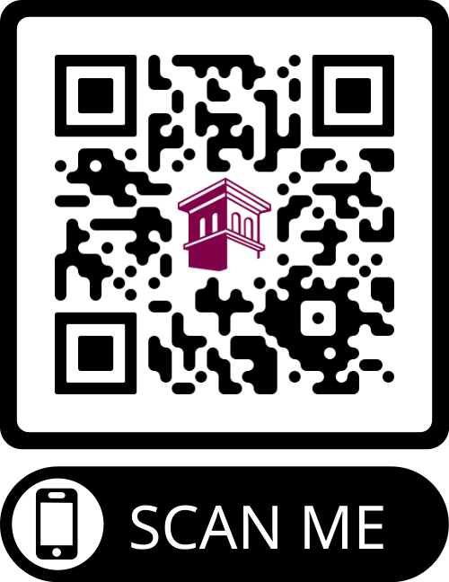
Explore the city!
Downtown Lancaster
Lancaster County Park
Outlets
Park City Center Mall
The Shops at Belmont

Slide 31
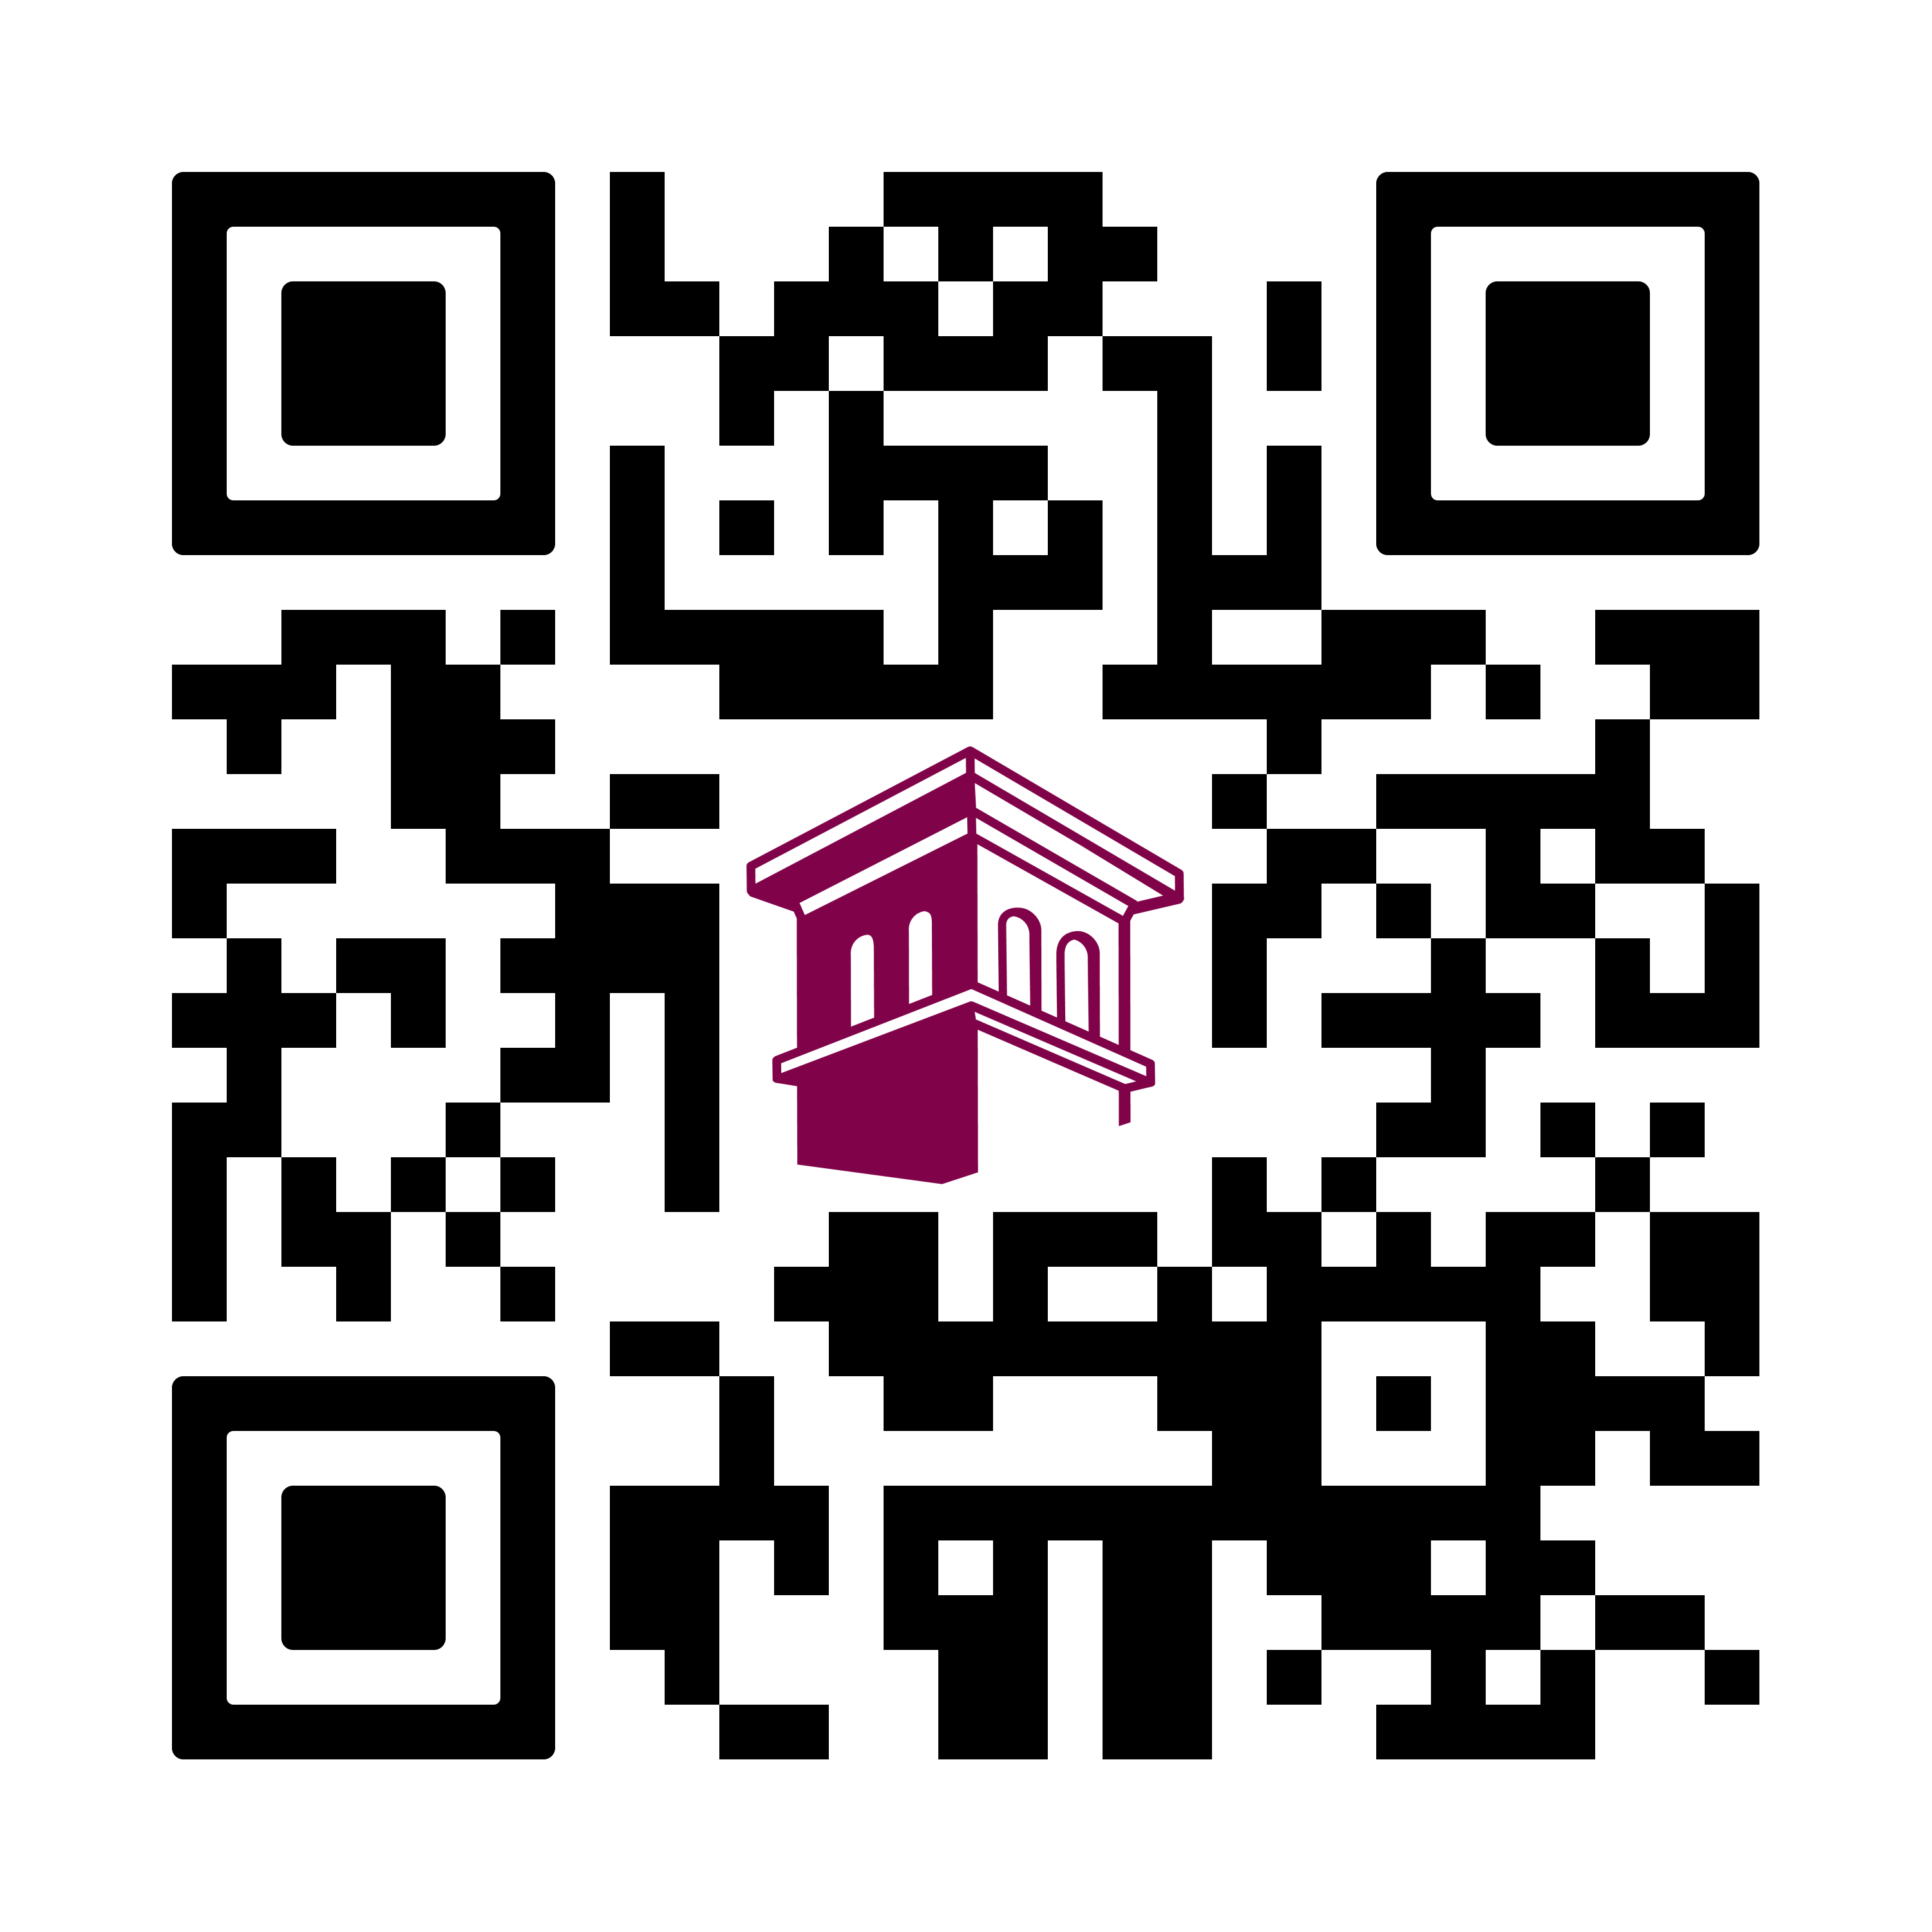
Tell us your thoughts!

Slide 32
Thank you for coming!
Don’t forget! New Student Orientation August 20 and August 21!
Want to grab some TSCT swag? The House of Champ is open until 4 p.m.!

